Slide 1
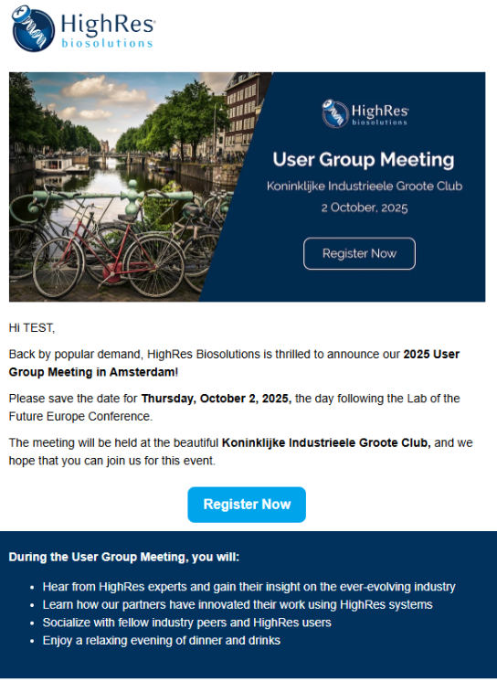
HighRes Bio: Event Support
Client Need
As the technology leader in lab automation, HighRes Biosolutions currently utilizes Salesforce CRM & HubSpot Marketing Hub. Affirma is their marketing vendor of record for strategy and ongoing implementation. HighRes attends and hosts numerous local and global events, such as co-sponsored and fully-hosted webinars, tradeshows and user group meetings. These events are critical for lead gen and nurturing customer relationships.
How Affirma Partners and Supports:
Email Campaigns
Organic Social Media
Paid Ads / Paid Social
SEO / Website Updates
Strategy & Best Practices
Video Production
Design & Event Branding
Webinar Production
On-Site Management
HubSpot Administration

Slide 2


Event Support: Landing Page
“The Affirma team is really getting a handle on what we do and how we want to present ourselves in the marketplace. In addition, they have been able to take a lot of work off our plates, so we can focus on our clients and other high-priority items.”
Brian O’Sullivan, Senior Vice-President

Slide 3

HighRes Bio: Event Support
Client Need
As the technology leader in lab automation, HighRes Biosolutions currently utilizes Salesforce CRM & HubSpot Marketing Hub. Affirma is their marketing vendor of record for strategy and ongoing implementation. HighRes attends and hosts numerous local and global events, such as co-sponsored and fully-hosted webinars, tradeshows and user group meetings. These events are critical for lead gen and nurturing customer relationships.
How Affirma Partners and Supports:
  Email Campaigns
  Organic Social Media
  Paid Ads / Paid Social
  SEO / Website Updates
  Strategy & Best Practices
  Video Production
  Design & Event Branding
  Webinar Production
  On-Site Management
  HubSpot Administration

Slide 4
Event Support: Landing Page
“The Affirma team is really getting a handle on what we do and how we want to present ourselves in the marketplace. In addition, they have been able to take a lot of work off our plates, so we can focus on our clients and other high-priority items.”
Brian O’Sullivan, Senior Vice-President

